Slide 1
Conservation of Energy

Slide 2
Energy Review
Kinetic Energy
  Associated with movement of members of a system
Potential Energy
  Determined by the configuration of the system
  Gravitational and Elastic Potential Energies will be studied later
Internal Energy
  Related to the temperature of the system

Slide 3
Types of Systems
Isolated systems
  Energy does not cross the boundary of the system
  Total energy of the system is constant
Non-isolated systems
  Energy can cross the system boundary in a variety of ways.
  Total energy of the system changes
Conservation of energy
  Can be used if no non-conservative forces act within the isolated system
  Applies to biological organisms, technological systems, engineering situations, etc

Slide 4
Ways to Transfer Energy Into or Out of A System
In non-isolated systems, energy crosses the boundary of the system during some time interval due to an interaction with the environment.
Some Means of Energy Transfer:
Work
Mechanical Wave.
Heat.
Matter Transfer
Electrical Transmission
Electromagnetic Radiation

Slide 5
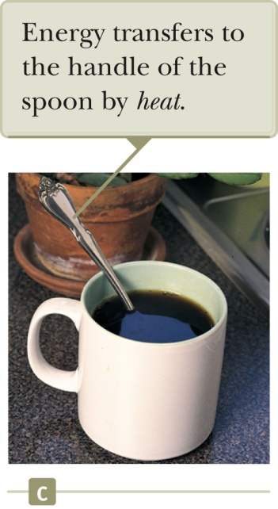
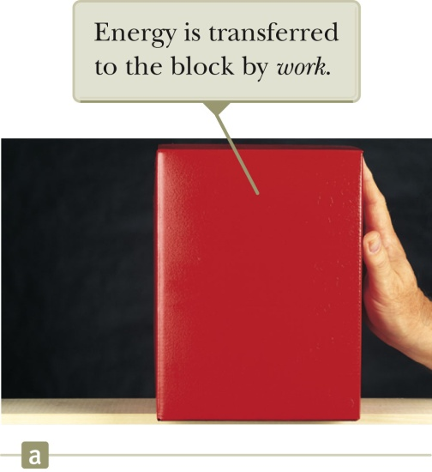
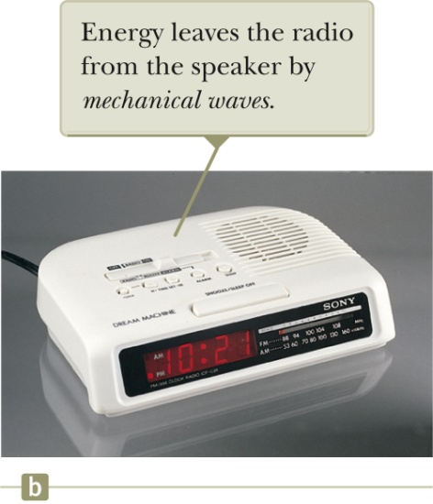
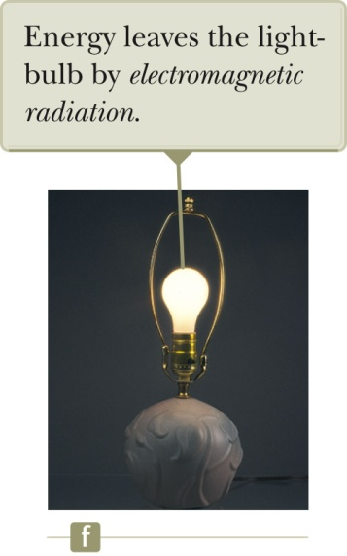
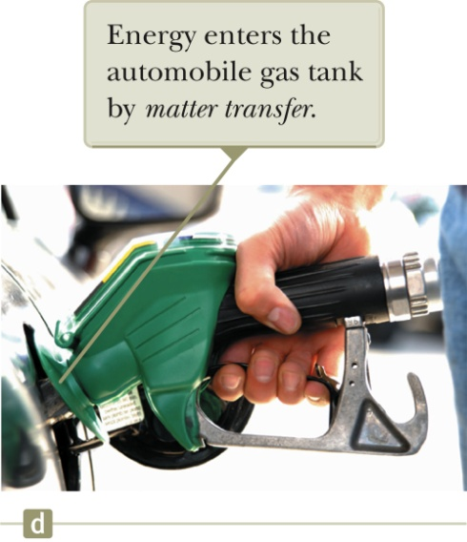
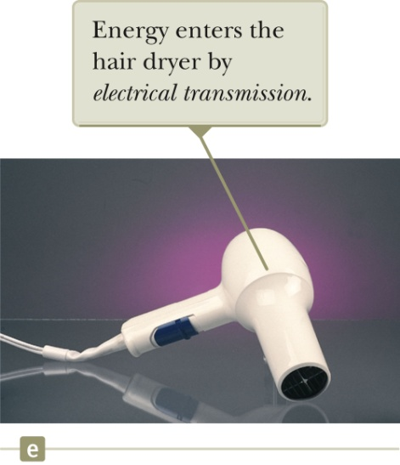
Examples of Ways to Transfer Energy
Section 8.1

Slide 6
Conservation of Energy
Energy is conserved
  This means that energy cannot be created nor destroyed.
  If the total amount of energy in a system changes, it can only be due to the fact that energy has crossed the boundary of the system by some method of energy transfer.

Slide 7
Isolated System
For an isolated system, ΔE_{mech} = 0
  Remember E_{mech} = K + U
  This is conservation of energy for an isolated system with no non-conservative forces acting.
If non-conservative forces are acting, some energy is transformed into internal energy.

Slide 8
Isolated System, cont.
The changes in energy can be written out and rearranged.
K_{f} + U_{f} = K_{i} + U_{i}
  Remember, this applies only to a system in which conservative forces act.

Slide 9
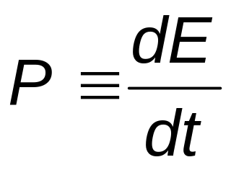
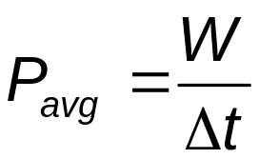
Power
Power is the time rate of energy transfer.
The instantaneous power is defined as
Using work as the energy transfer method, this can also be written as

Slide 10
Units of Power
The SI unit of power is called the watt.
  1 watt = 1 joule / second = 1 kg . m² / s³
A unit of power in the US Customary system is horsepower.
  1 hp = 746 W
Units of power can also be used to express units of work or energy.
  1 kWh = (1000 W)(3600 s) = 3.6 x10⁶ J

